Slide 1
Dry bean clustering and classifications
Made by
Tanay Bobade
Sunil Rathod
Tushar ingle
Kashyap Nath

Slide 2
INTRODUCTION
This project involved building a classification model to identify different varieties of dry beans using computer vision and machine learning techniques. The goal was to obtain uniform seed classification and improve the efficiency of bean sorting in the agriculture industry.
The model can be used in various applications, such as in the food industry, specifically in the processing and packaging of dry beans.
The model can help in the accurate classification of the different types of dry beans, leading to improved product quality control and better sorting of beans according to their types.
Additionally, the model can be used in agricultural research to study and classify different varieties of dry beans.
The results from the analysis can also be used to develop new products from the different types of beans. Overall, the model can help in improving the efficiency and accuracy of dry bean classification and processing, leading to better product quality and increased profitability in the food industry.

Slide 3
DATA EXPLORATION
First, we import the data and check its size.
We find that there some missing values in the dataset.
Then we have replaced the null values to there mean values of that column
and also we have checked for droping those null values by comparing both experiment
we have found that when we drop the null values we were getting high accuracy by droping
null values
We observe that the dataset contains 16 features, out of which 15 are numerical and one is categorical (Class).
We calculate the mean, median, standard deviation, and quartiles of the numerical data to gain insight into the distribution of the data.

Slide 4
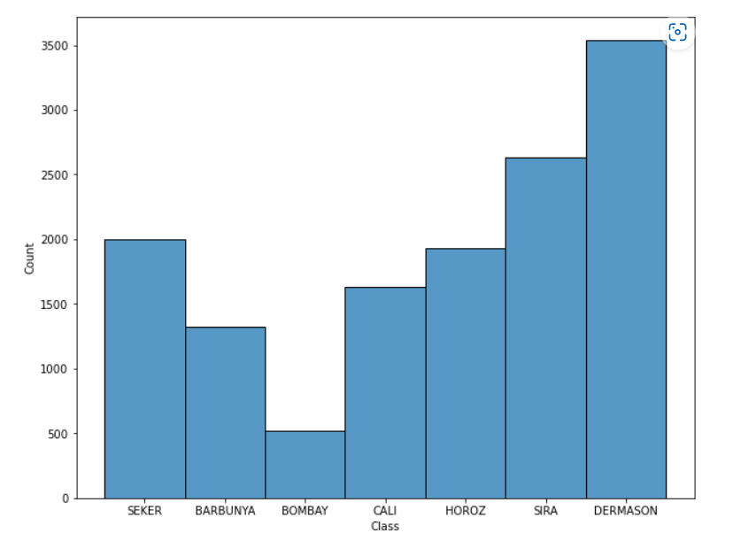
Univariate Analysis
We plot a histogram of the ‘Class’ feature and observe that the data is not evenly distributed across the seven classes, with some classes having a significantly larger number of observations than others.
We check the distribution of numerical variables and find that the features are not normally distributed.

Slide 5
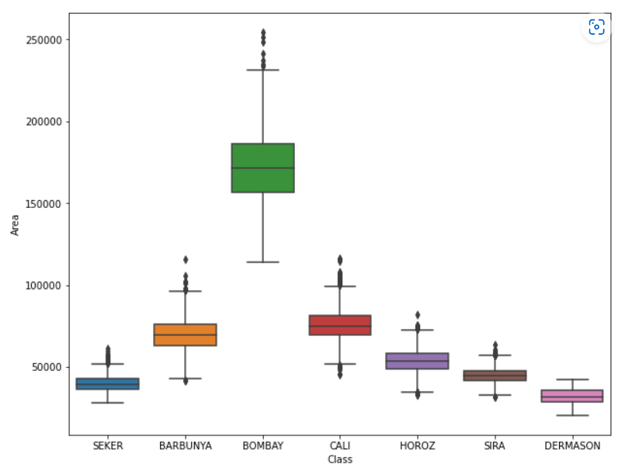
Bivariate Analysis
We plot box plots of ‘Area’ and ‘Perimeter’ segregated by different classes to understand the relationship between the features and the target variable.
We observe that there is significant variation in the features across different classes.

Slide 6
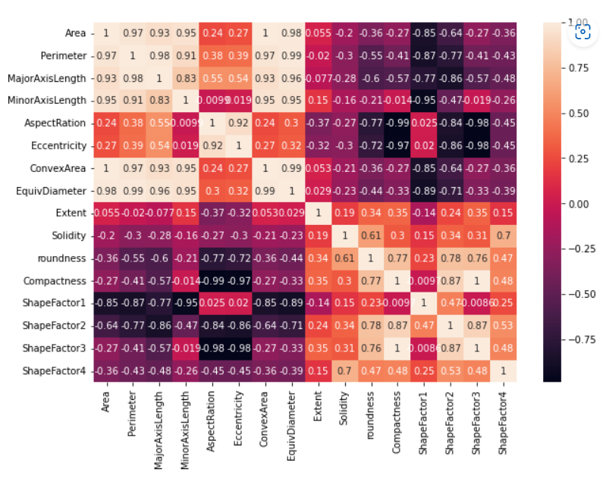
Bivariate Analysis
We calculate the Pearson correlation between the features and plot a heatmap to visualize the correlations.
We observe that some features are highly correlated, and we drop these features to avoid multicollinearity.

Slide 7
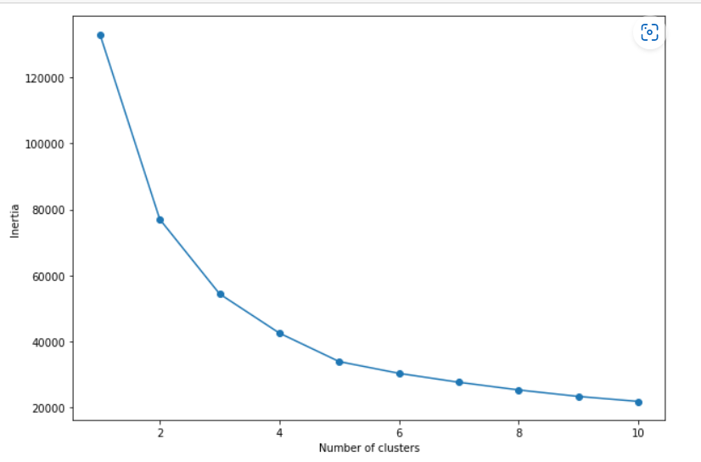
Clustering
We split the data into training and testing sets and scale the variables before using the KNN algorithm to predict the ‘Class’ variable.
We use the elbow method to select the best value of K for KNN and find that K = 3 is the optimal value. We then drop the ‘Class’ column and cluster the data using the K means algorithm.
We use the elbow method to find the optimal value of K for K means and find that K = 7 is the optimal value.
We then plot a histogram of different K means clusters segregated by ‘Class’ and observe that the clusters overlap with different classes, suggesting that the features alone may not be sufficient to accurately predict the target variable.

Slide 8
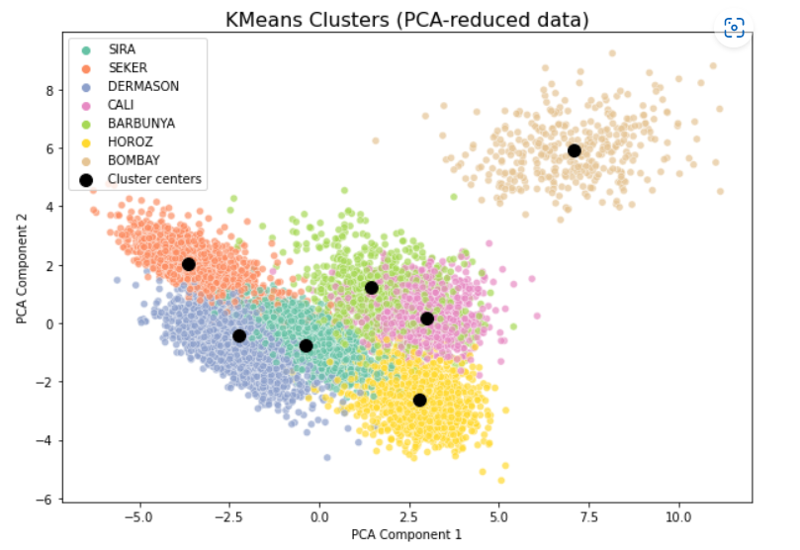
PCA
Finally, we use PCA to decrease the dimensionality of the data to two dimensions and use K means clustering with K = 7 to cluster the data.
We plot the clusters and observe that the clusters overlap with different classes, indicating that the features alone may not be sufficient to accurately predict the target variable

Slide 9
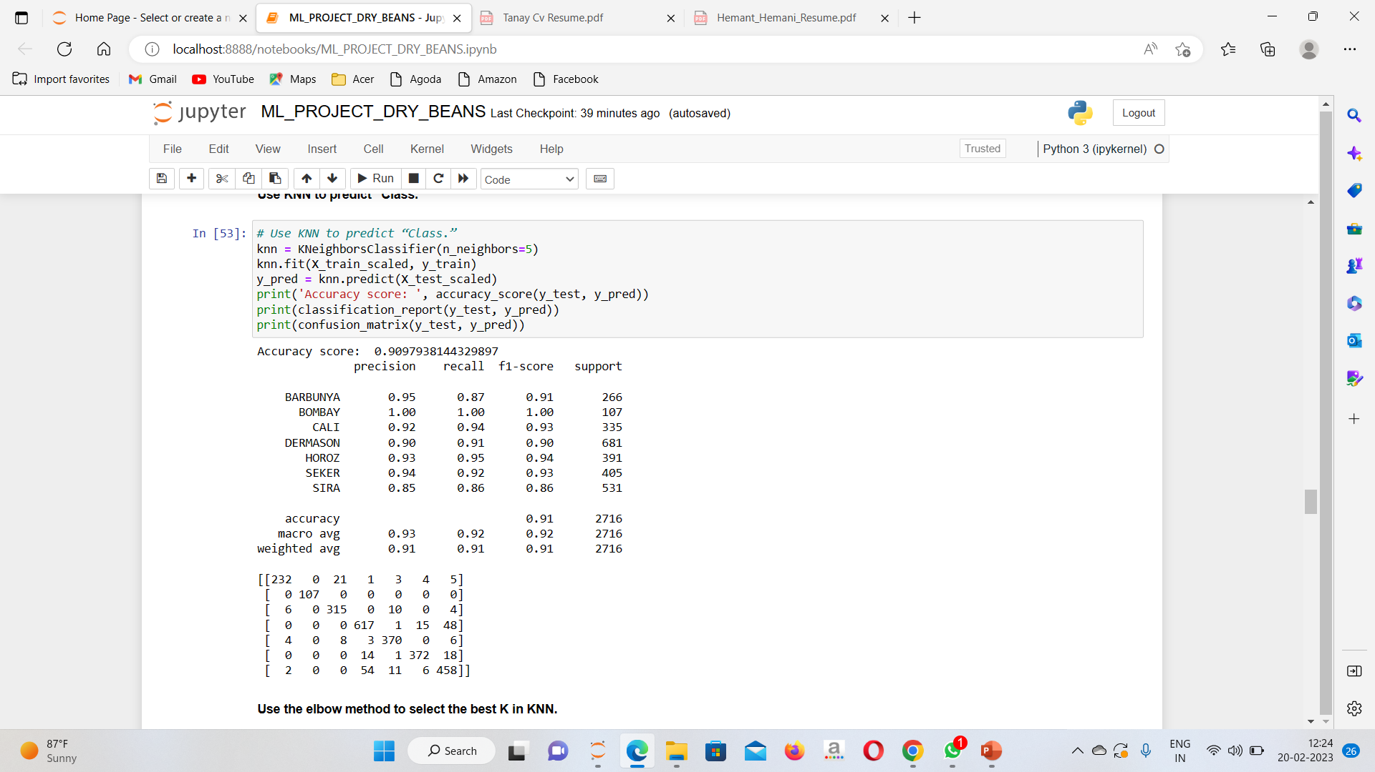
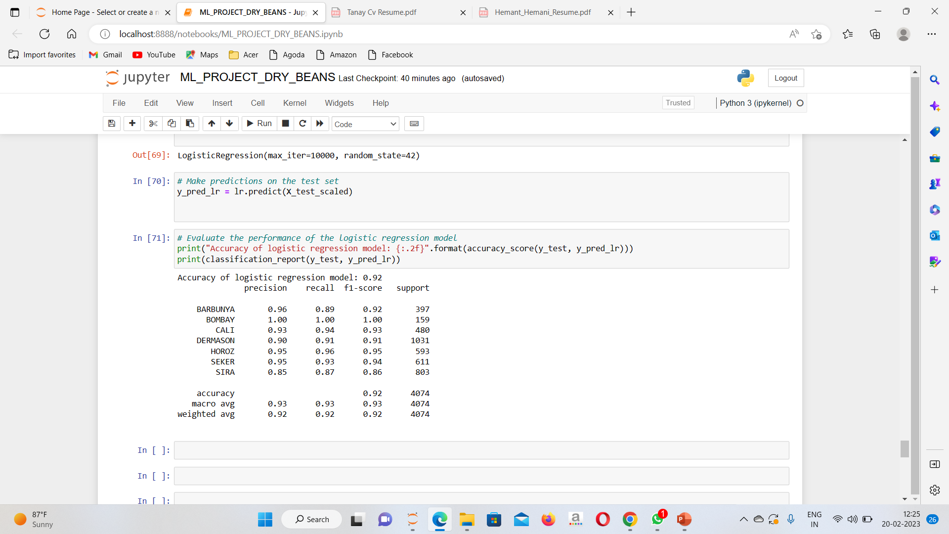
Accuracy Report

Slide 10
Conclusion
The benefits of automating the bean sorting process using this model include increased efficiency, accuracy, and consistency. By reducing the need for manual labour, the cost of bean sorting can also be reduced.
Furthermore, the model can be used to sort beans at a much faster rate than manual labour, which can be especially important during peak seasons when large volumes of beans need to be processed quickly.
Overall, the model developed in this project has potential applications in the agriculture industry and can contribute to improving the efficiency and cost-effectiveness of bean sorting

